Slide 1

SOFTWARE ENGINEERING
FRELLO
FINAL REVIEW

Slide 2
Team
YASH RAY 19BCE0235
SHRUTI SHREYA 19BCE0133
SOURAV PANDEY 19BCE0365

Slide 3

Agenda
ABSTRACT
SCOPE
PROJECT DESCRPTION
RESULTS/OUTCOMES

Slide 4
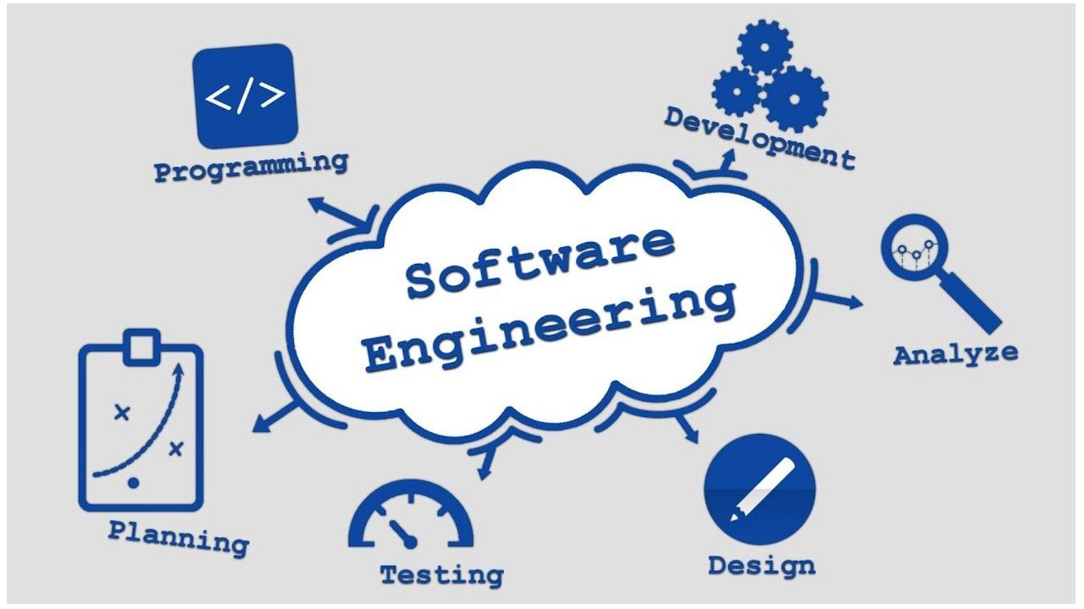

ABSTRACT
Our Project is a software which will help set personal goals for an individual. Developing a software requires determination apart from all other aspects and skills and what better way to stay determined than to set your own goals and meet them. It will enable every user to create an account and organize their work as per their own needs and comfort. They will be secured, so only that particular user will be able to access and edit their timeline. Our Project is general-purpose, Web-based software, which can be used for complex multi-user projects for business. In addition to tracking the status of tasks, it includes a powerful system for logging and reporting time spent on tasks. Combined with powerful reporting mechanisms, it also provides many customisation options for a better view and interface.

Slide 5

SCOPE:-
To enable any user or organization to increase their daily efficiency by storing and maintaining different timelines and progress of their work routine or project deadlines privately/publicly as per their own needs and comfort and analyse their timetable.

Slide 6
PROJECT DESCRIPTION
To create a platform for users/organizations to organize their work and store timeline of their work routine. Enable every user to create an account and organize their work as per their own needs and comfort. They will be secured, so only that particular user / organization will be able to access and edit their timeline. They include work hours trackers, communication platforms, project and task organizers, scheduling software, team management systems, calendar apps, and report making tools, and many others. It also provides a customisation window where user can change background or text colour for better interactivity and interface. Lists created by users can store any project milestone or activities followed by the due deadline of their project. It can also store start and finish date for each project segment. Later all the details can be stored and viewed by the user in offline mode for better accessibility and user satisfaction.

Slide 7
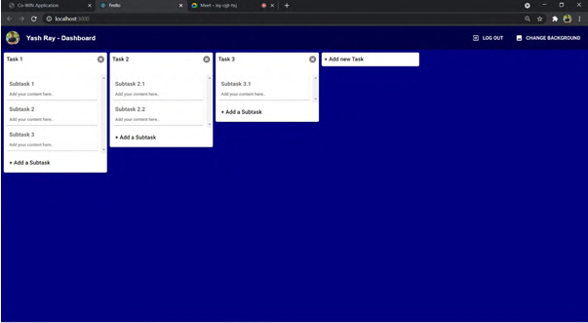
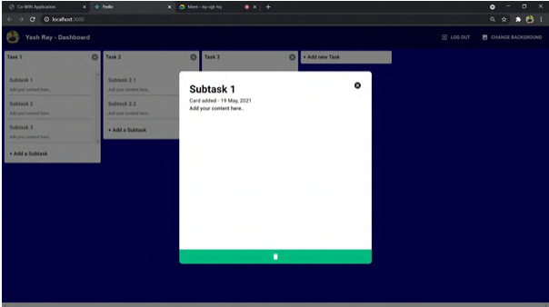
RESULTS/OUTCOMES

Slide 8
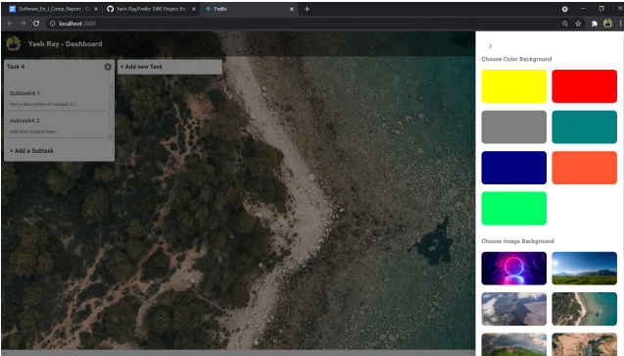

Slide 9

THANK YOU

